Slide 1
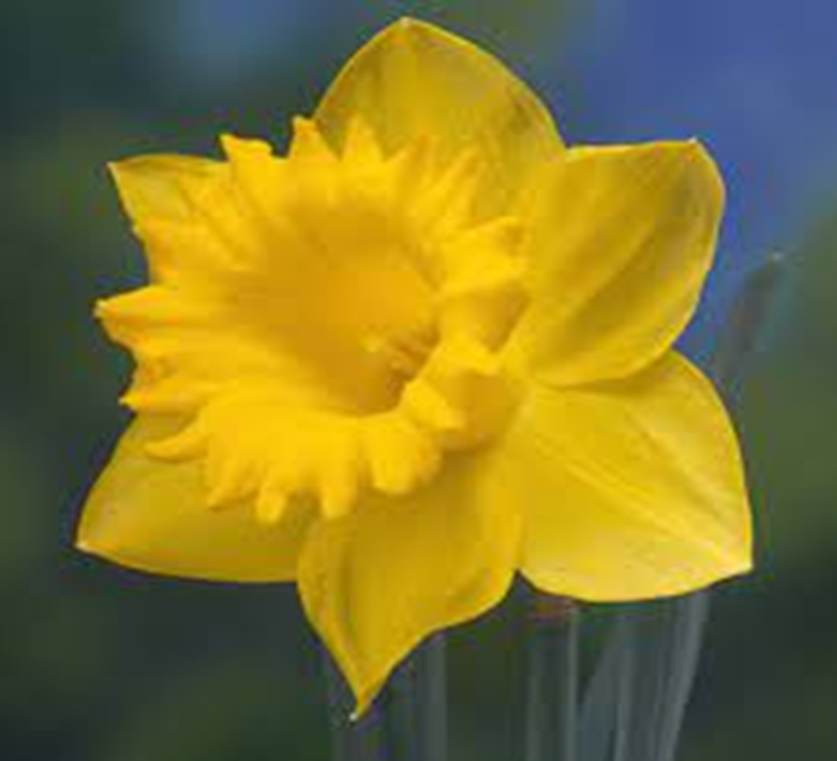
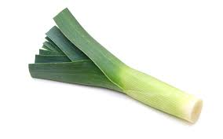
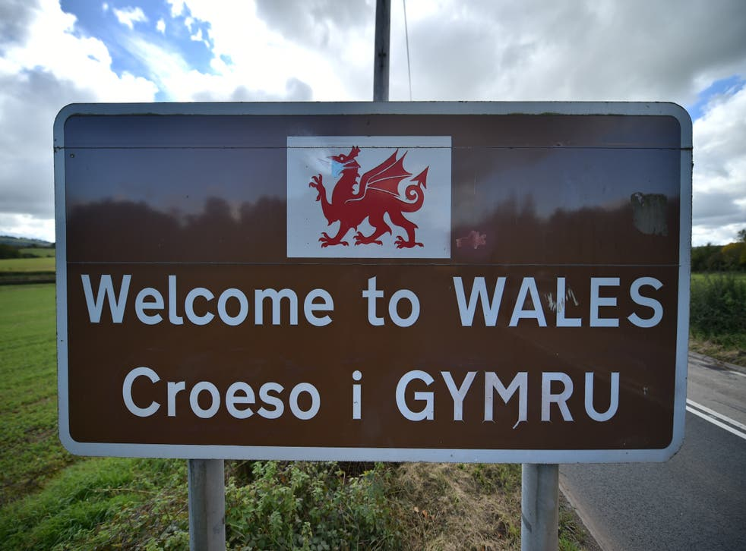
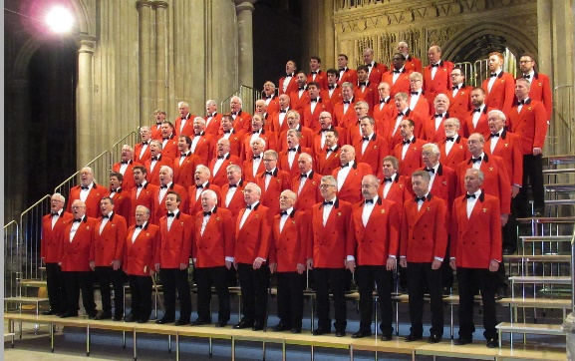
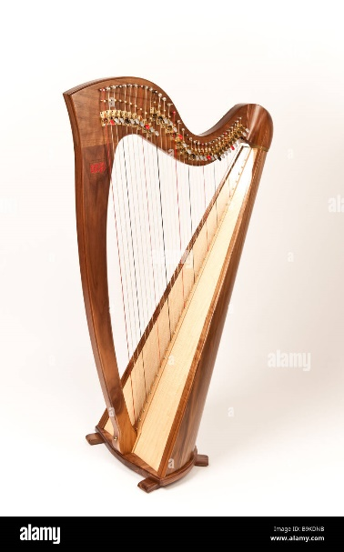

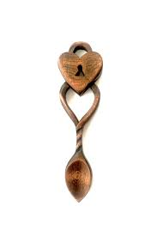
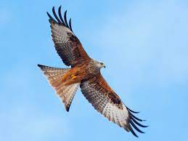
Our welsh symbols

Slide 2
Ddraig goch
The daffodil
The leek
welsh language
Welsh love spoon
Male voice choirs
The red kite
The welsh harp

Slide 3
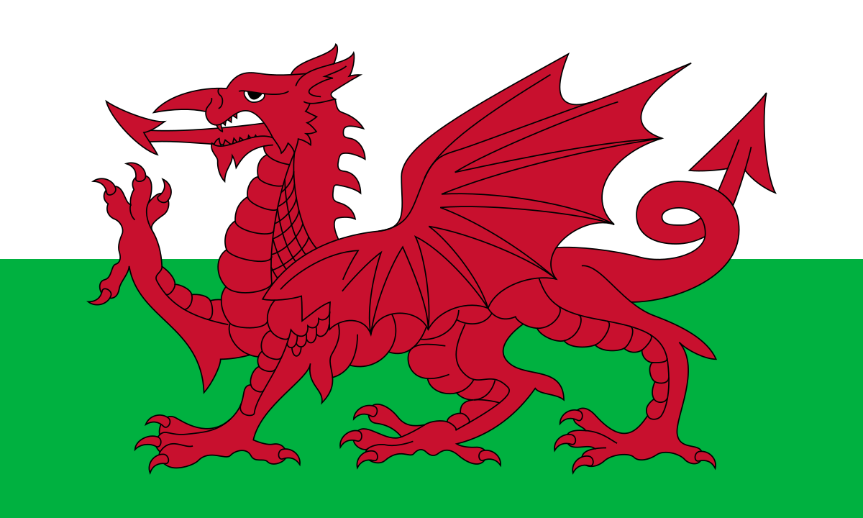
Ddraig goch
The dragon appeared on the battle flags of various British soldiers on their way to Rome in the 4th century. It was later adopted by 5th century Welsh kings who were keen to show their authority following the Roman withdrawal

Slide 4
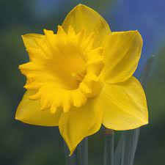
The daffodil
The daffodil symbolises rebirth and new beginnings. It's one of the first flowers to bloom at the end of winter, announcing the beginning of spring and signifying the end of the cold, dark days Less commonly, daffodils may also symbols of creativity, energy, resilience, forgiveness and vitality

Slide 5
The leek
This root vegetable is so well established as part of Welsh culture that wearing a leek to signify you come from Wales is noted as an 'ancient tradition' in William Shakespeare's Henry V, first performed in the 16th century

Slide 6
welsh language
The Welsh language is a key part of the region's culture and identity, being the primary language spoken in some of our communities, as well as having a significant presence in many workplaces, learning institutions, and around our town and village streets

Slide 7
Welsh love spoon
The history of the Welsh love spoon began over 300 years ago in Wales, when young men, often sailors on sea voyages would carve ornate wooden spoons known as “love spoons”. They would present these love spoons to a woman as a romantic gift

Slide 8
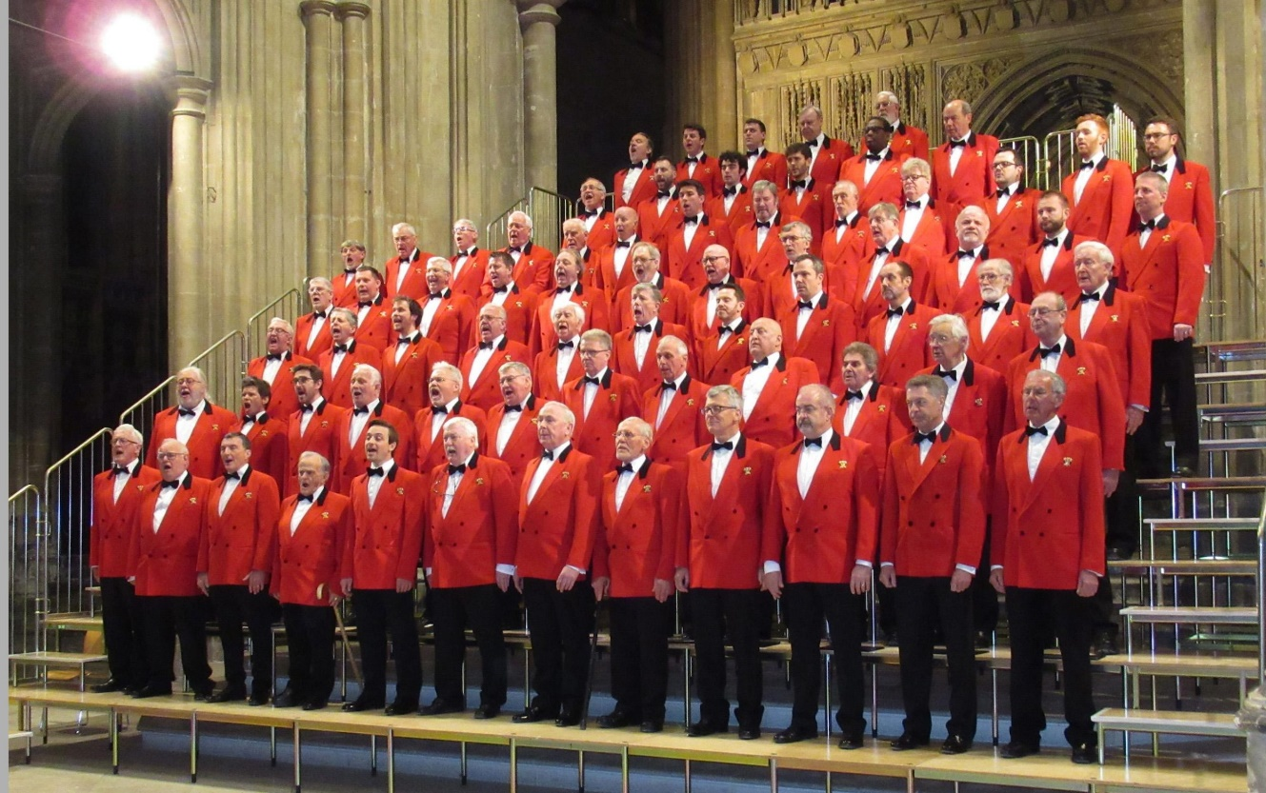
Male voice choirs
Men are usually divided into four groups: countertenor, tenor, baritone, and bass.

Slide 9
The red kite
kite, any of numerous birds of prey belonging to one of three subfamilies (Milvinae, Elaninae, Perninae) of the family Accipitridae. Typically, a kite is lightly built, with a small head, partly bare face, short beak, and long narrow wings and tail. Kites occur worldwide in warm regions

Slide 10

The welsh harp
Harps were associated also with David in the Old Testament and used as the symbol of St. Cecilia, patron saint of musicians. But if seen on jewellery, or in funerary art, it can be seen as a symbolic of worship in heaven or hope

